Slide 1
Portfolio Management at DOE/NNSA
FEDERAL CPIC FORUM
October 8, 2014
Kirby Brace
Chief Operating Officer
(240) 778-6922 (o) (954) 558-5455 (c)
kirby.brace@appsential.com
www.appsential.com
This information is confidential and proprietary and may not be reproduced in whole or part unless authorized in writing by an authorized representative of Appsential.

Slide 2
Overview
Who We Are
DOE/NNSA Background
Planning, Programming, Budgeting & Evaluation (PPB&E)
Tying the Mission/Goals to the Work Scope
    Priorities
    Dependencies
    Duplication
    Value
IT CPIC (300’s/53’s)
An Integrated Solution

Slide 3
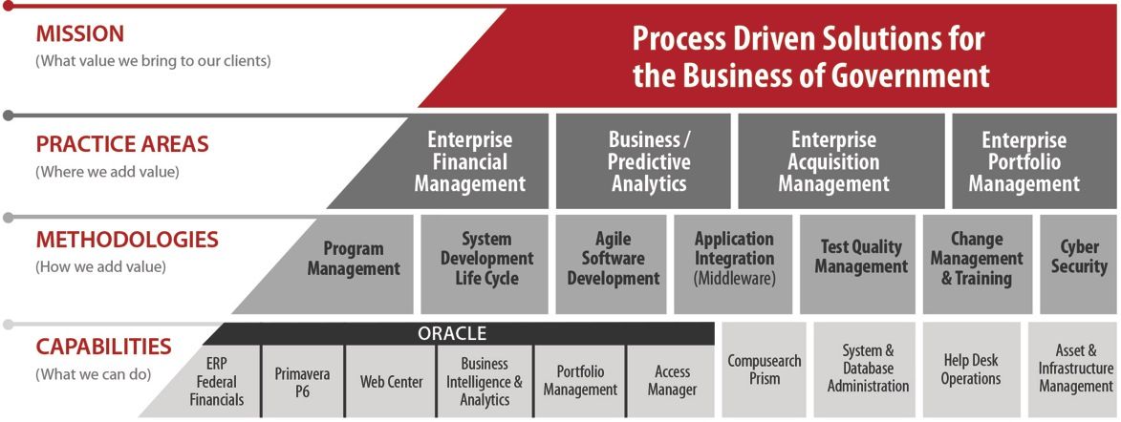
Who We Are
Appsential is a customer focused management and IT solutions small business – delivering process driven, repeatable solutions. Appsential supports all key mission critical business systems at the Department of Energy (DOE) including Oracle: Federal Financials (EBS), Web Center Suite, Fusion, Business Intelligence, Data Warehouse, as well as Primavera P6 and Portfolio Management.

Slide 4
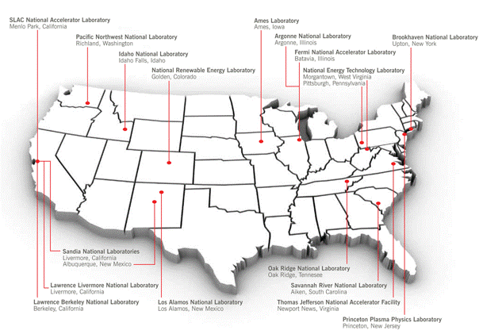
DOE/NNSA Background
NNSA Defense Programs manages a diverse portfolio of programs and projects supported by a network of national labs and production plants.
Solve Problems in science, energy, and national security
Provide Capabilities essential to our nation’s continued science and technology primacy
Operate Infrastructure that serve tens of thousands of scientists collaborating on solutions to pressing and complex problems.
Promote innovation that advances U.S. economic competitiveness and contributes to prosperity.
Manufacture components required to maintain the U.S. weapons stockpile

Slide 5



Planning, Programming, Budgeting and Evaluation (PPB&E)
Portfolio
Management
Portfolio
Management
Fiscally UNCONSTRAINED
Defines high level scope
Identifies Priorities
Fiscally CONSTRAINED
Identifies emerging requirements
Re-balance based on competing requirements
PLAN
PROGRAM
Vision:
WHAT needs to get done
Reality:
HOW it will get done
Validation:
Are we ON TRACK
Justification/
Distribution:
WHY its needed.
BI Reporting
Hyperion
Administrator/Secretary Reviews
OMB Reviews
Technical Reviews
Finalize after OMB pass back and prioritization
Run budget scenarios
Prepare Congressional Justification
EVALUATE
BUDGET

Slide 6
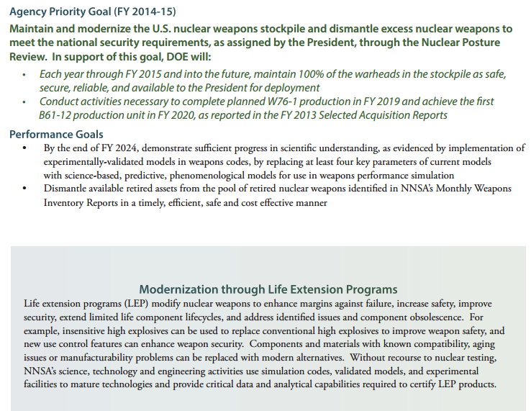
Linking the Mission, Goals, and Programs
Mission goals can be easily linked to programs, projects and activities.

Slide 7
Tying the Mission/Goals to the Projects/Activities
  Priorities are easily tracked through the creation of portfolios.
Mission
DOE
Theme 1
Nuclear
Security
Goal 2
Goal 1A
Goal 1B
1.0 Defense Programs
Goal 1C
Goal 1D
Goal 2A
Goal 2B
Goal 2C
WBS 1B.2
WBS 1B.2
1.1 Directed Stockpile Work
Item
Item
1.1.1 Inertial Confinement Fusion Ignition & High Yield Campaign
WBS 1B.1.2
1.1.2 Life Extension Work and other Major Alterations
Oracle Federal Financials
1.1.1.2 Ignition
1.1.2.1 B61 LEP Dev & Prod
Primavera (PPM)
WBS 1B.1.2.1
1.1.1.2.3 Ignition & HEDWP Platform Development
1.1.2.1.1 Systems Integration and Requirements Management
Item
1.1.1.2.3.1 Ignition & HEDWP Experiment Execution
1.1.2.1.1.3 Advanced Systems Testing
1.1.2.1.1.3.1 Yield

Slide 8
Tying the Mission/Goals to the Projects/Activities
  Dependencies are easily identified by linking portfolios & activities.
Mission
DOE
Theme 1
Nuclear
Security
Goal 2
Goal 1A
Goal 1B
1.0 Defense Programs
Goal 1C
Goal 1D
Goal 2A
Goal 2B
Goal 2C
WBS 1B.2
WBS 1B.2
1.1 Directed Stockpile Work
Item
Item
1.1.1 Inertial Confinement Fusion Ignition & High Yield Campaign
WBS 1B.1.2
1.1.2 Life Extension Work and other Major Alterations
Oracle Federal Financials
1.1.1.2 Ignition
1.1.2.1 B61 LEP Dev & Prod
Primavera (PPM)
WBS 1B.1.2.1
1.1.1.2.3 Ignition & HEDWP Platform Development
1.1.2.1.1 Systems Integration and Requirements Management
Item
1.1.1.2.3.1 Ignition & HEDWP Experiment Execution
1.1.2.1.1.3 Advanced Systems Testing
1.1.2.1.1.3.1 Yield

Slide 9
Tying the Mission/Goals to the Projects/Activities
  Duplicity is easily identified through assessment of work scope across activities.
Mission
DOE
Theme 1
Nuclear
Security
Goal 2
Goal 1A
Goal 1B
1.0 Defense Programs
Goal 1C
Goal 1D
Goal 2A
Goal 2B
Goal 2C
WBS 1B.2
WBS 1B.2
1.1 Directed Stockpile Work
Item
Item
WBS 1B.1.2
1.1.2 Life Extension Work and other Major Alterations
Oracle Federal Financials
1.1.2.1 B61 LEP Dev & Prod
Primavera (PPM)
WBS 1B.1.2.1
Kansas City Plant
1.1.2.1.1.2.1.1 Impact Sensor
1.1.2.1.1 Systems Integration and Requirements Management
1.1.2.1.1.2.1 Radar System
Item
Sandia
1.1.2.1.1.2.1.2 Pre-Flight System
Los Alamos
1.1.2.1.1.2.1.3 Radar Antenna

Slide 10
Tying the Mission/Goals to the Projects/Activities
  Value is obtained by understanding how it all fits together.
Mission
DOE
Theme 1
Nuclear
Security
Goal 2
Goal 1A
Goal 1B
1.0 Defense Programs
Goal 1C
Goal 1D
Goal 2A
Goal 2B
Goal 2C
WBS 1B.2
WBS 1B.2
1.1 Directed Stockpile Work
Item
Item
1.1.1 Inertial Confinement Fusion Ignition & High Yield Campaign
WBS 1B.1.2
1.1.2 Life Extension Work and other Major Alterations
Oracle Federal Financials
1.1.1.2 Ignition
1.1.2.1 B61 LEP Dev & Prod
Primavera (PPM)
WBS 1B.1.2.1
Kansas City Plant
1.1.2.1.1.2.1.1 Impact Sensor
1.1.1.2.3 Ignition & HEDWP Platform Development
1.1.2.1.1 Systems Integration and Requirements Management
1.1.2.1.1.2.1 Radar System
Item
Sandia
1.1.2.1.1.2.1.2 Pre-Flight System
1.1.1.2.3.1 Ignition & HEDWP Experiment Execution
1.1.2.1.1.3 Advanced Systems Testing
Los Alamos
1.1.2.1.1.2.1.3 Radar Antenna
CPIC Module
Exhibit 300/53
IT CPIC Works Scope
General Work Scope
1.1.2.1.1.3.1 Yield

Slide 11
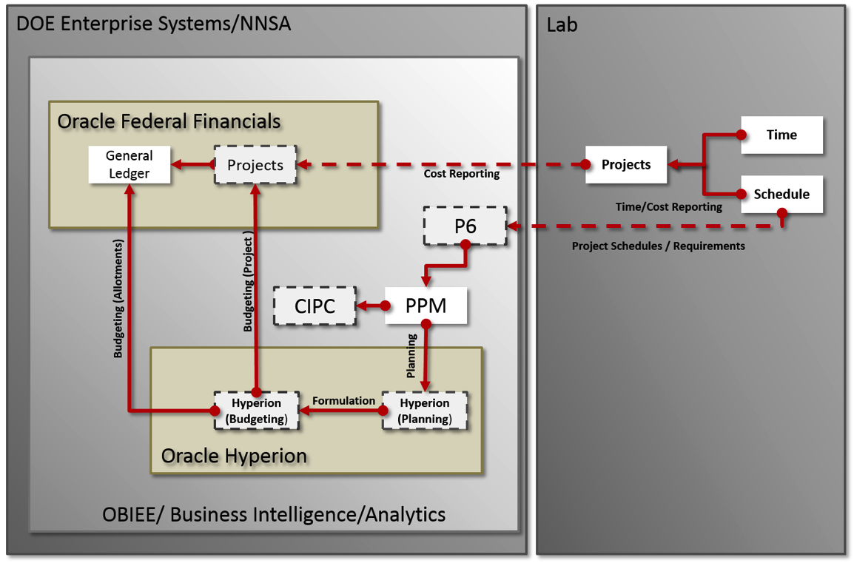
The Integrated Solution
Integrated data from the labs and plants provides transparency into how priorities are executed, ensures efforts are not duplicated, and identifies the true cost of DP programs through dependencies.
WBS/Project Schedules
300’s/53’s

Slide 12
Questions?

